Slide 1


SIIM-ISIC Melanoma Classification
By
Pranathi Manusanipalli - 1059113
Gnanatej cherukuru - 1387186
Rishvita bhumireddy - 1341006

Slide 2
INTRODUCTION
Skin cancer is the most common type of cancer. It occurs due to the abnormal growth of skin cells, usually on the areas exposed to sunlight. Melanoma is responsible for 75% of skin cancer deaths, despite being the least common skin cancer.
Melanoma is a deadly disease, but if caught early, most melanomas can be cured with minor surgery.
Image analysis tools that automate the diagnosis of melanoma will improve dermatologist's diagnostic accuracy. Better detection of melanoma can positively impact millions of people.
Using patient-level contextual information may help the development of image analysis tools, which could better support clinical dermatologists.

Slide 3
GOALS
The objective of the project is to accurately identify the likeliness that images of skin lesions of patients represent melanoma based on the data provided and certain features present in data
We are going to use different algorithms to implement SIIM-ISIC Melanoma Classification and check which method gives us the maximum model performance.
In short, we are trying to analyze the following points
1. Is it possible to predict if a person has cancer based on the data which is provided?
2. Understand which algorithm has the highest performance score
3. To apply concepts of transfer learning for improving the performance

Slide 4
DATASET
Kaggle Dataset: https://www.kaggle.com/c/siim-isic-melanoma-classification/data
The images are provided in DICOM format. This can be accessed using commonly available libraries like pydicom and contains both image and metadata.
Images are also provided in JPEG.
Metadata is also provided in CSV files.

Slide 5
ALGORITHMS
Logistic Regression
XGBoost
CNN - Convolutional Neural Network
Transfer Learning
VGG16
DenseNet

Slide 6
XGBoost
Packages used: pandas, numpy, xgboost, sklearn, matplotlib, seaborn, plotly, itertools, os
We used xgboost library to identify melanoma in images of skin lesions. As the data is imbalanced, we tried to increase the data of the minority class. This model is predicting if the patient has melanoma and received an accuracy of 67%.
Logistic Regression
Packages used: numpy, pandas, matplotlib, seaborn, cv2, pydicom, sklearn
We used logistic regression to identify if the patient has melanoma or not. As the data is imbalanced, we under sampled the majority class. After predicting, received an accuracy of 74%.

Slide 7
CNN
Packages used: keras, pandas, numpy, sklearn, matplotlib, h5py,PIL, seaborn, random, os
We used keras library to build Convolutional Neural Network (CNN) model that takes images as input and classify benign and malignant cancer types. Since the data is unbalanced, we performed data augmentation and increased the size of minority class(here malignant) and trained the model for 3 epochs on 24528 images. By the end we achieve an accuracy of 84% with a loss of 0.2
Transfer Learning
Packages used: pandas, numpy, tensorflow, cv2, PIL, seaborn, keras, matplotlib, sklearn, tensorflow, tqdm, itertools, functools
Ensemble learning is the process by which multiple models, such as classifiers or experts, are strategically generated and combined to solve a particular computational intelligence problem.
I have trained the model using transfer learning model VGG16 and DenseNet model to predict whether images are Malignant or benign. We trained the models with 5 epochs and achieved an accuracy of 98% and loss of 0.09 for VGG16 model and accuracy of 98% and loss of 0.87 for densenet model

Slide 8
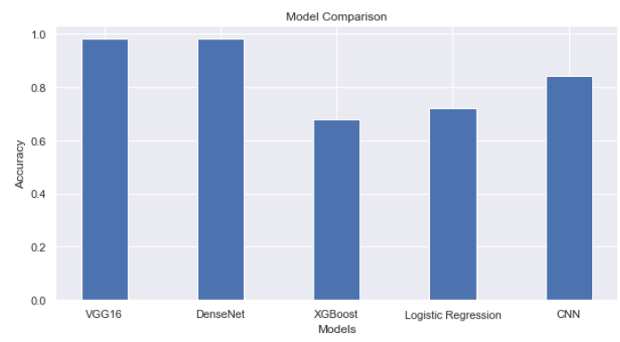
MODEL COMPARISON

Slide 9
REFERENCES
https://www.sciencedirect.com/science/article/pii/S2001037014000464
https://towardsdatascience.com/machine-learning-in-healthcare-detecting-melanoma-70147e1b08de
https://www.kaggle.com/zhuangliu1939/siim-isic-melanoma-classification-xgboost

